Slide 1
Draft Angle Marking
Zhen

Slide 2
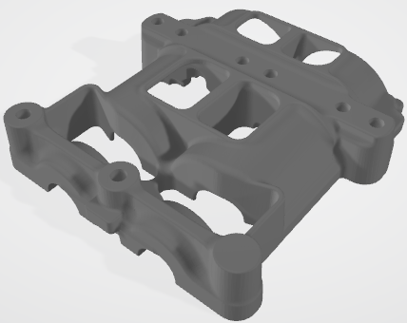
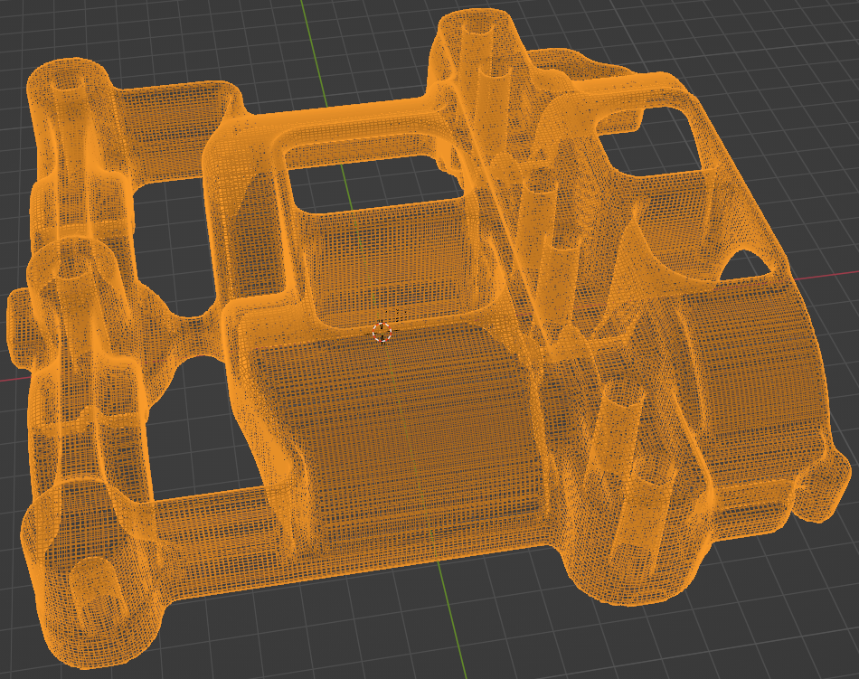
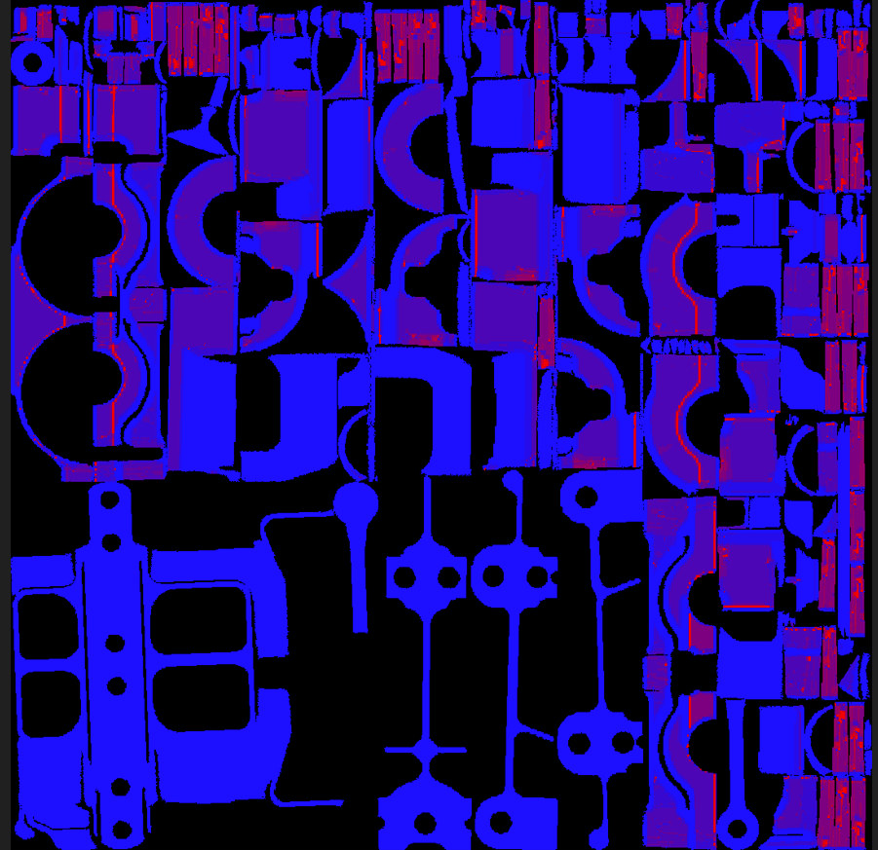
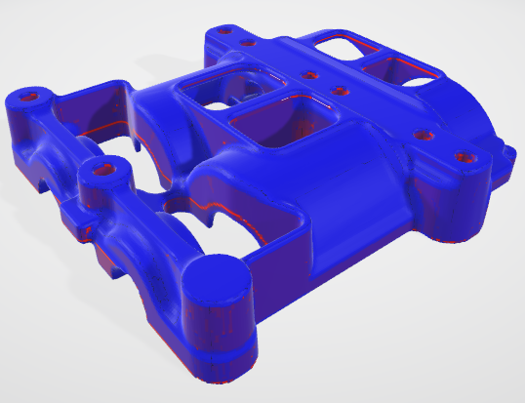
Procedure
Remeshing
Tangent calculated
Visualization
Color marking

Slide 3
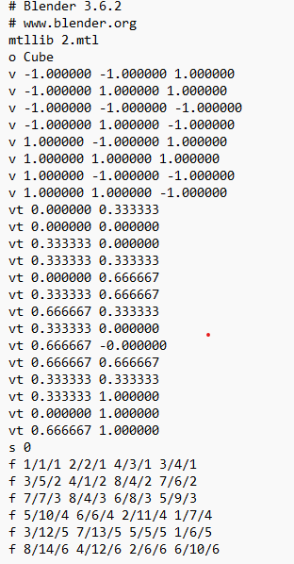
Tangent calculated
Create OBJ file output, organizing data as vertex coordinates, texture vertex coordinates, and face definitions.
Calculate the normal vectors for each face using their vertex coordinates.
Determine the cosine value based on the pulling direction and vector.
Use the cosine value to calculated tangent value

Slide 4
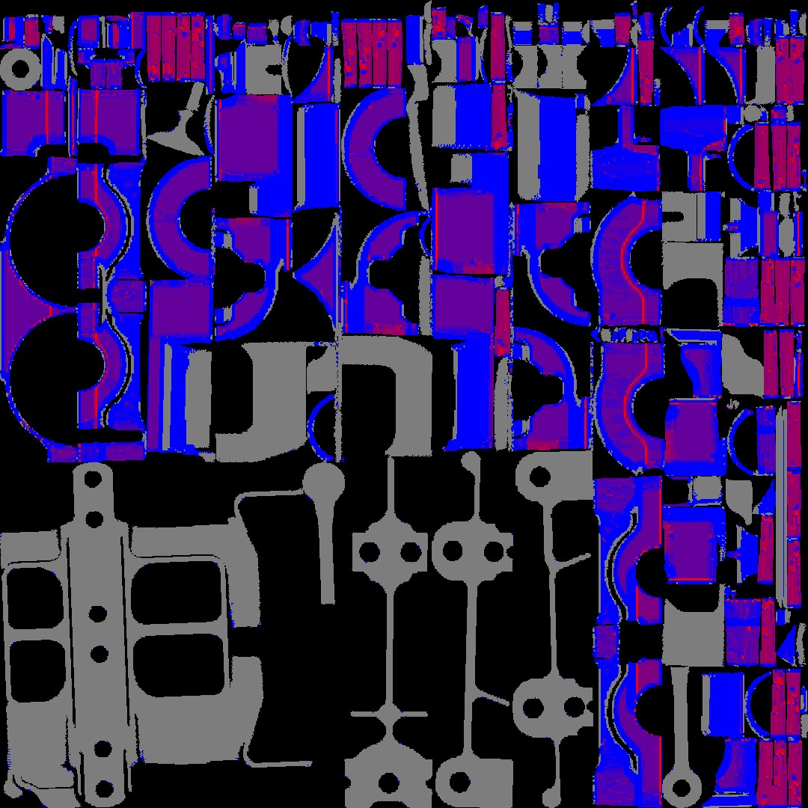
Tangent calculated
6. Define color bins as follows: if the tangent value ranges from 0 to 0.05, the color transitions from red to blue. For tangent values ranges from 0.05 to 0.6, the color set red. When the tangent value larger than 0.6, assign the color grey.

Slide 5
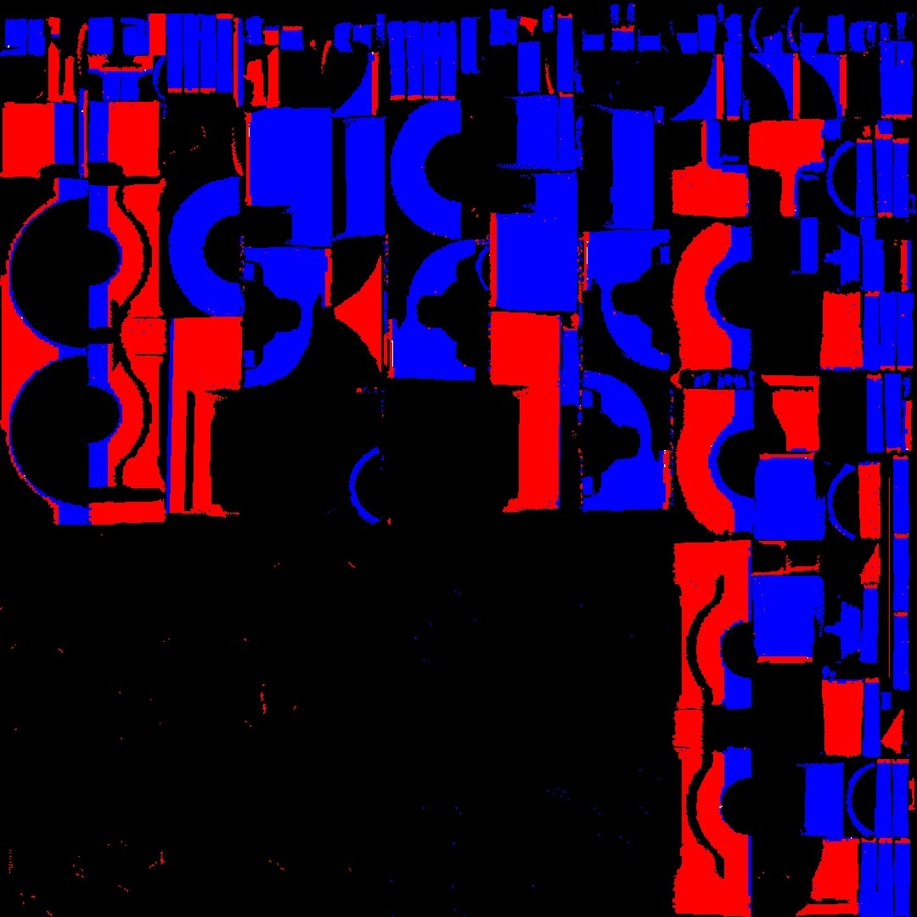
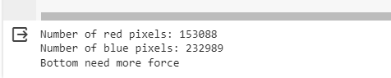
Ejection direction
Assign the color red if the tangent value is greater than 0 and less than 0.6. If the tangent value is less than 0 and greater than -0.6, assign the color blue. Then, compare the pixel colors of red and blue to determine the ejection direction.

Slide 6
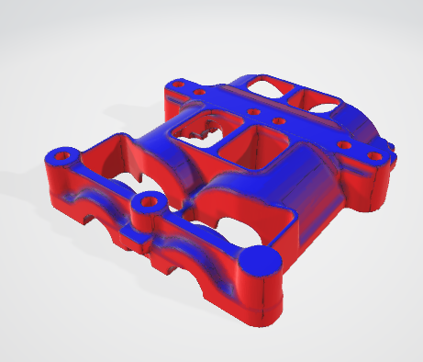
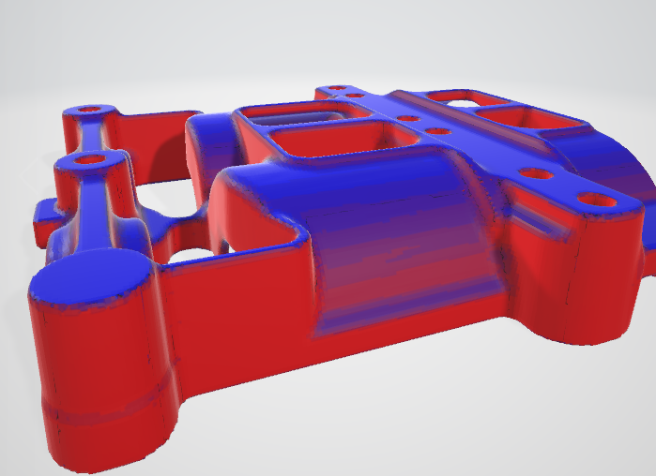
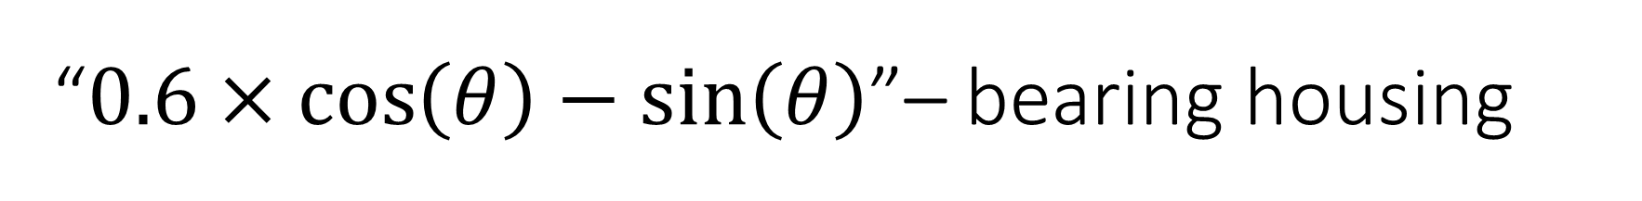
“$0.6×\cos\left(θ\right)−sin⁡\left(θ\right)$”– bearing housing

Slide 7
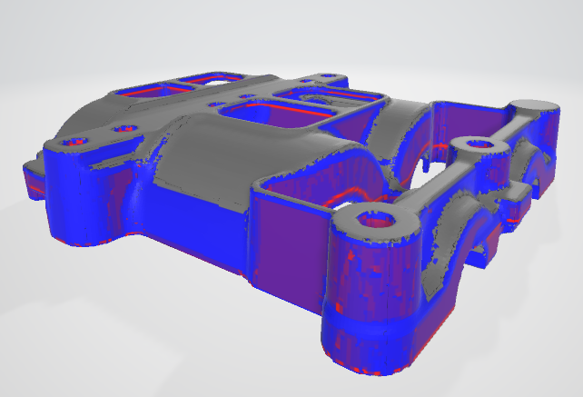
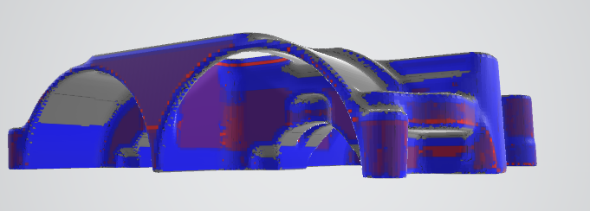
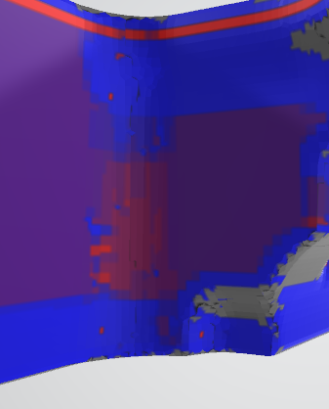
Abs tangent– bearing housing

Slide 8
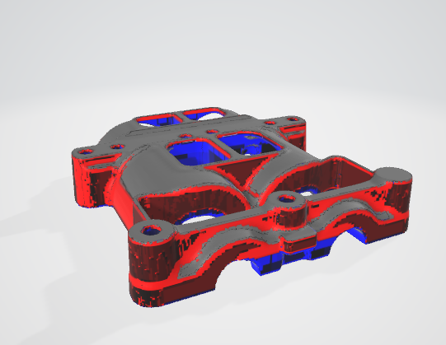
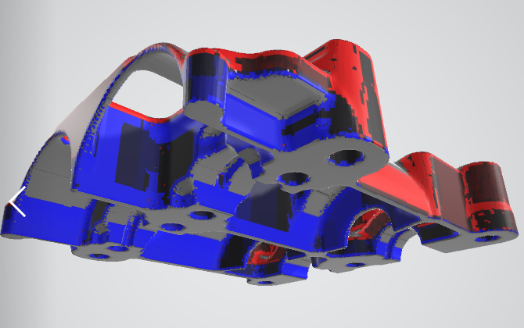
tangent– bearing housing

Slide 9
Link
https://github.com/zyang63/Die_casting_ejection

